Slide 1
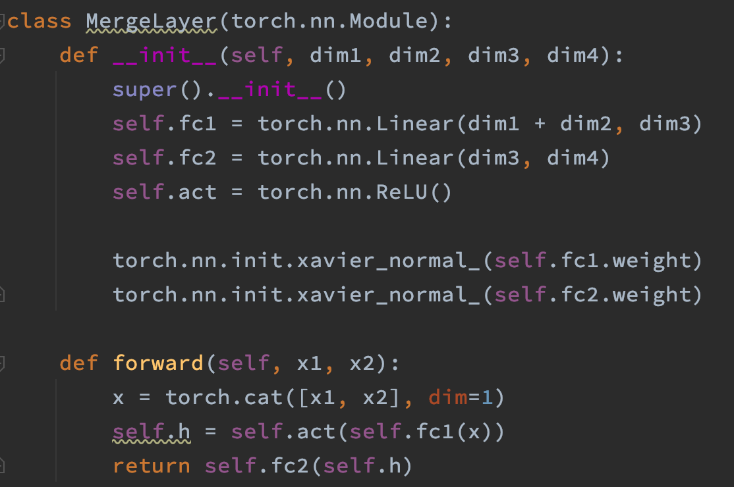
Why there are negative value

Slide 2
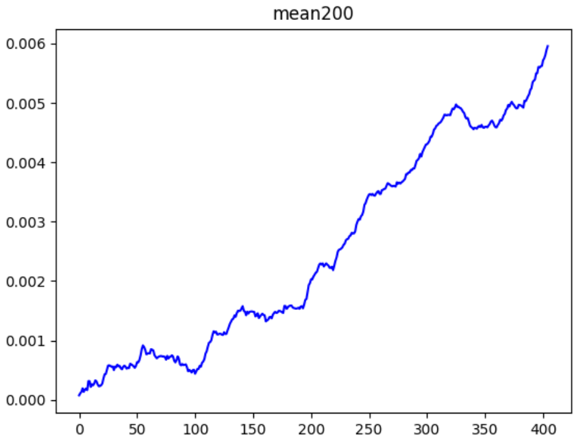
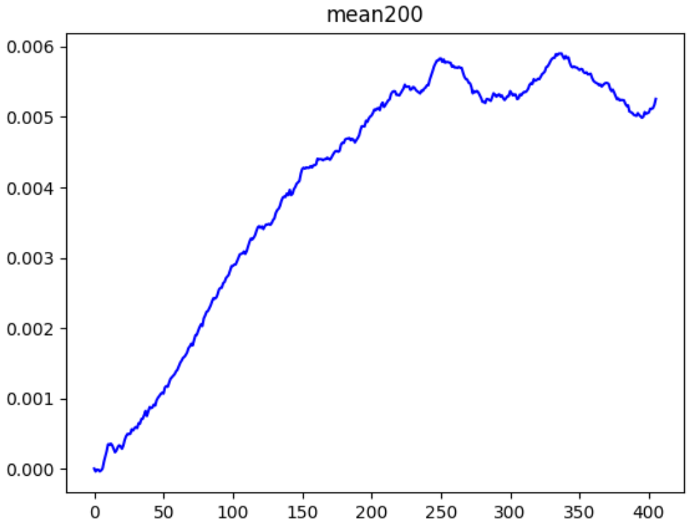
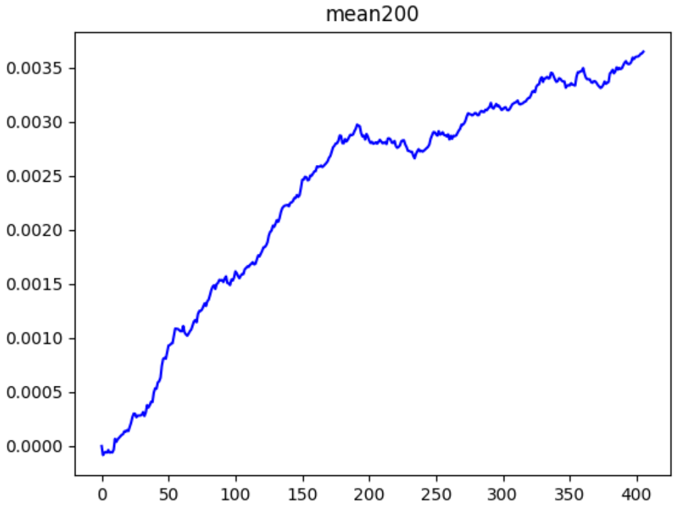
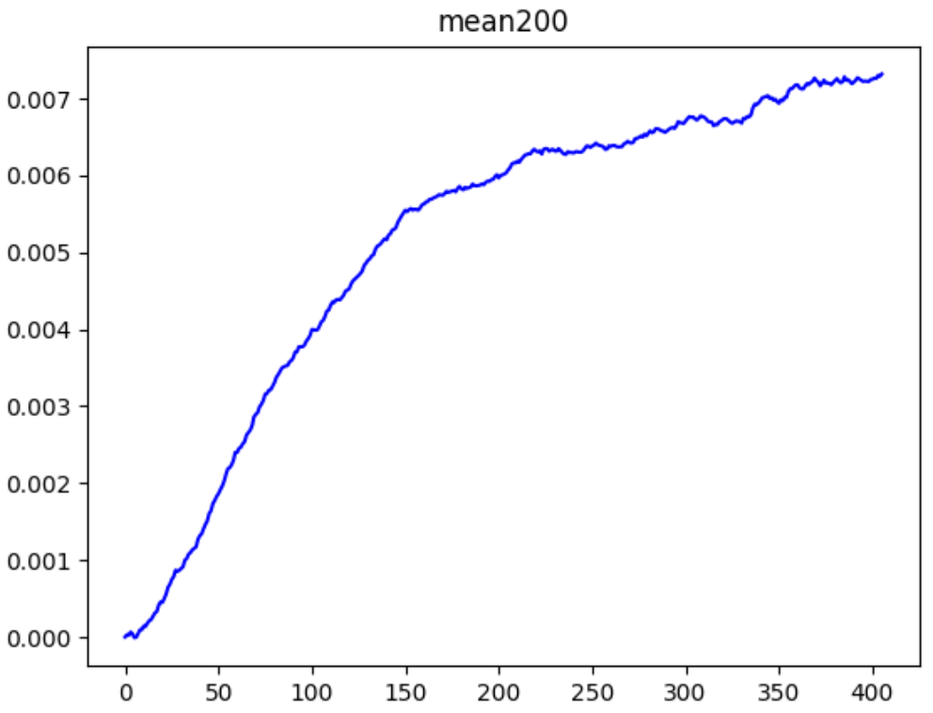
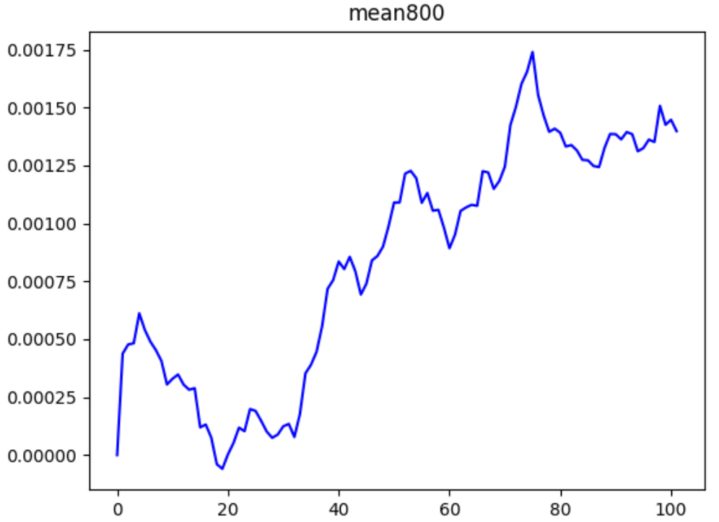
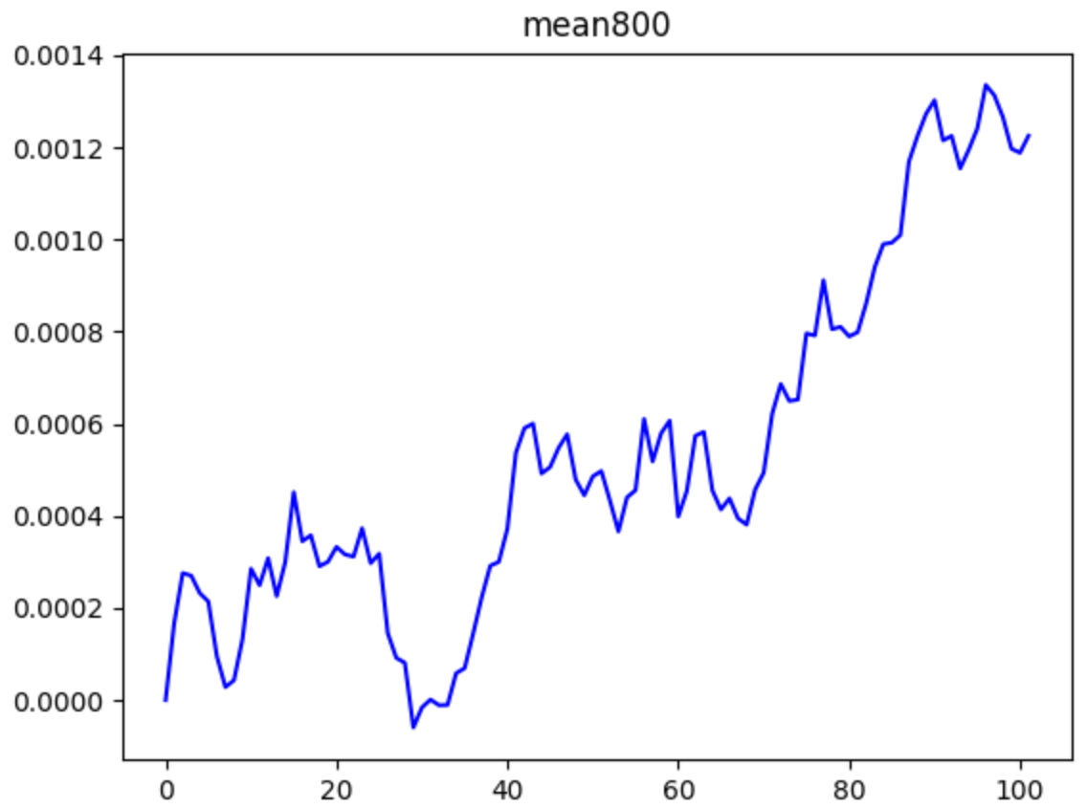
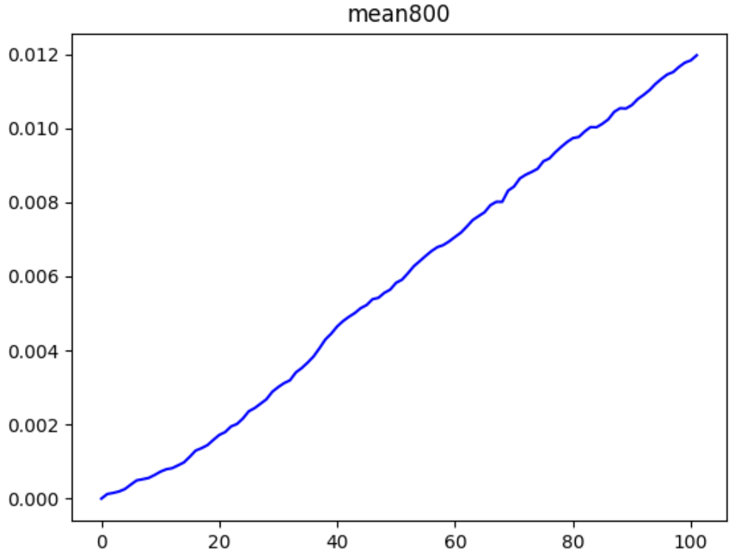
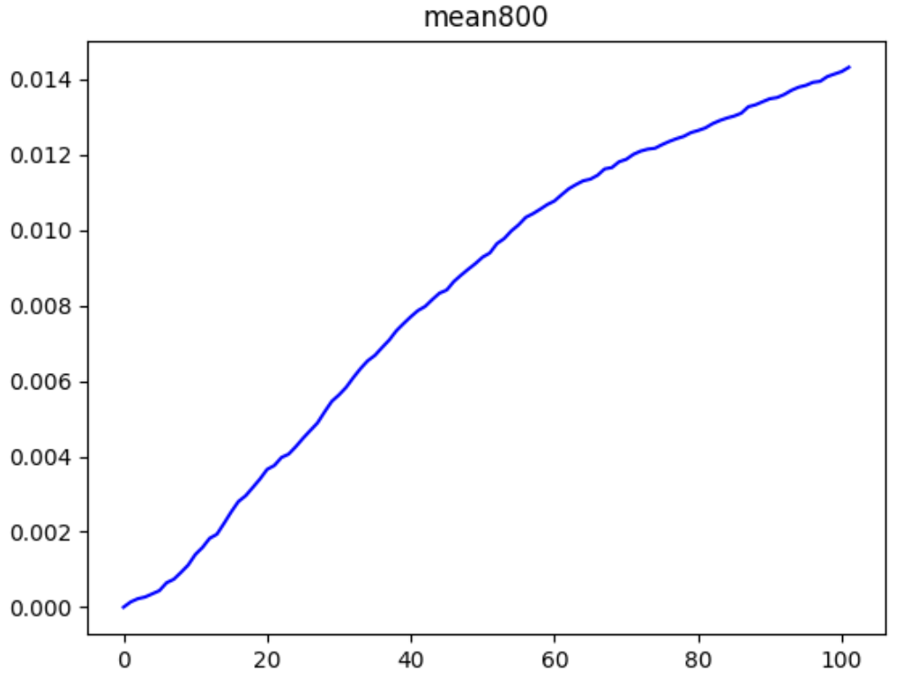
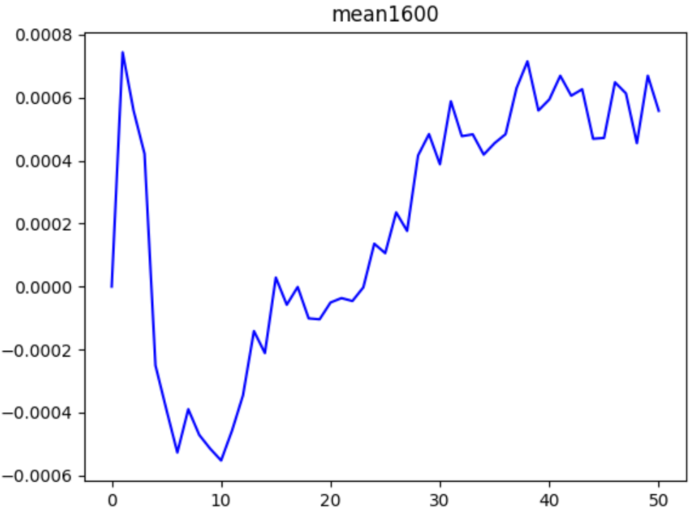
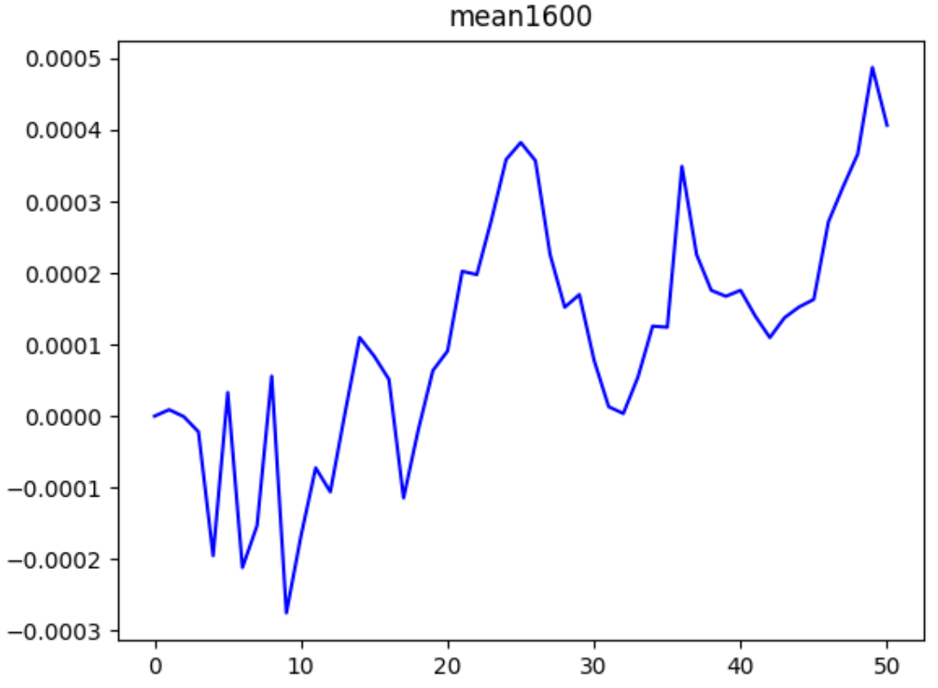
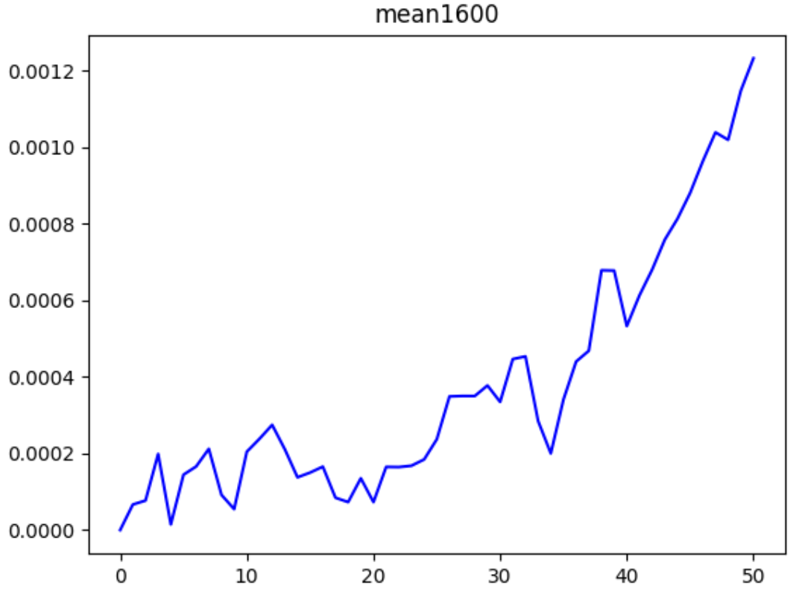
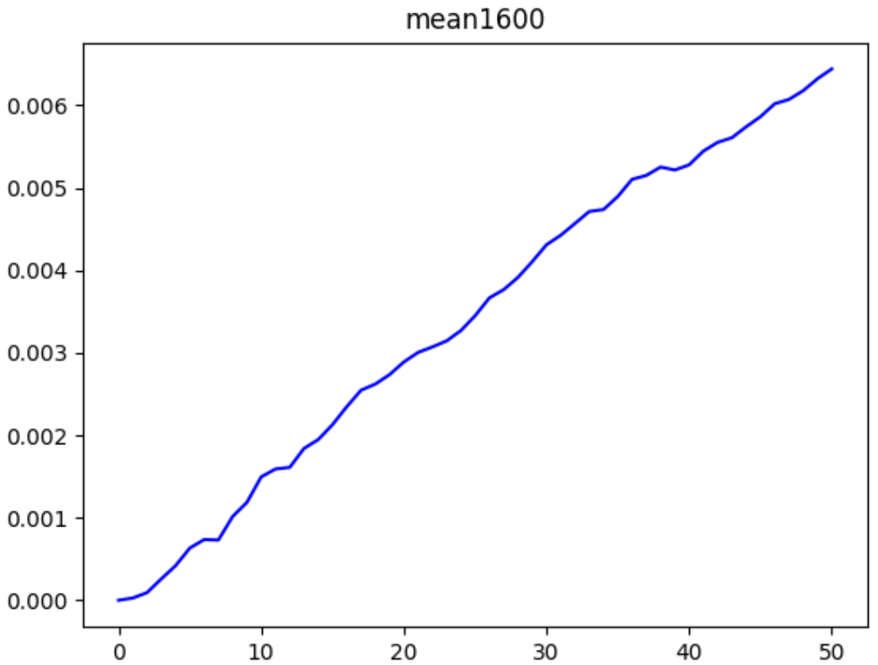
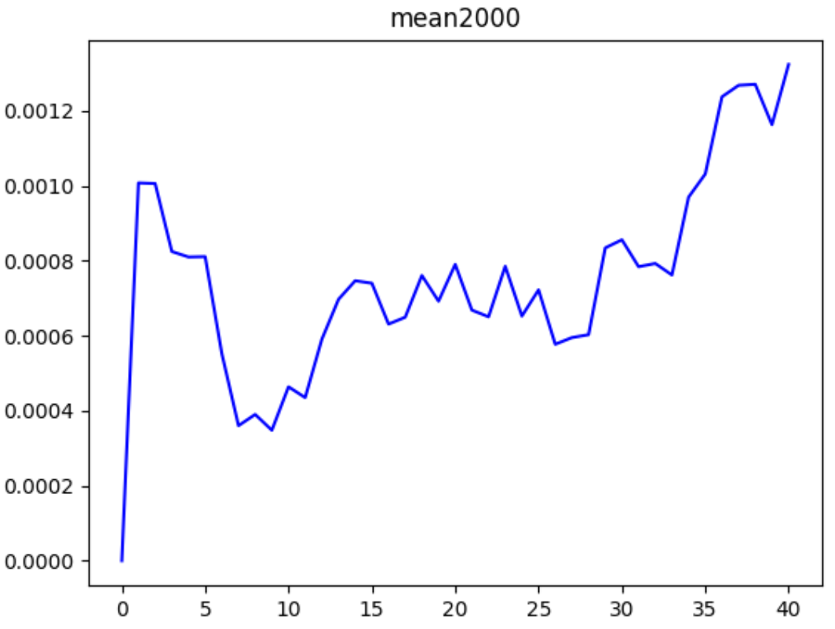
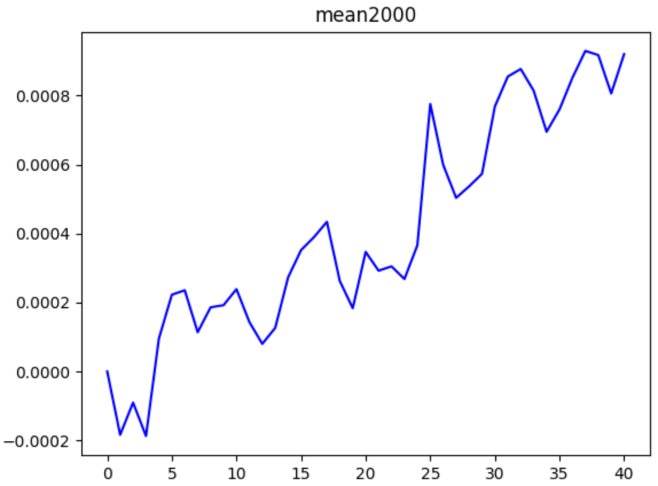
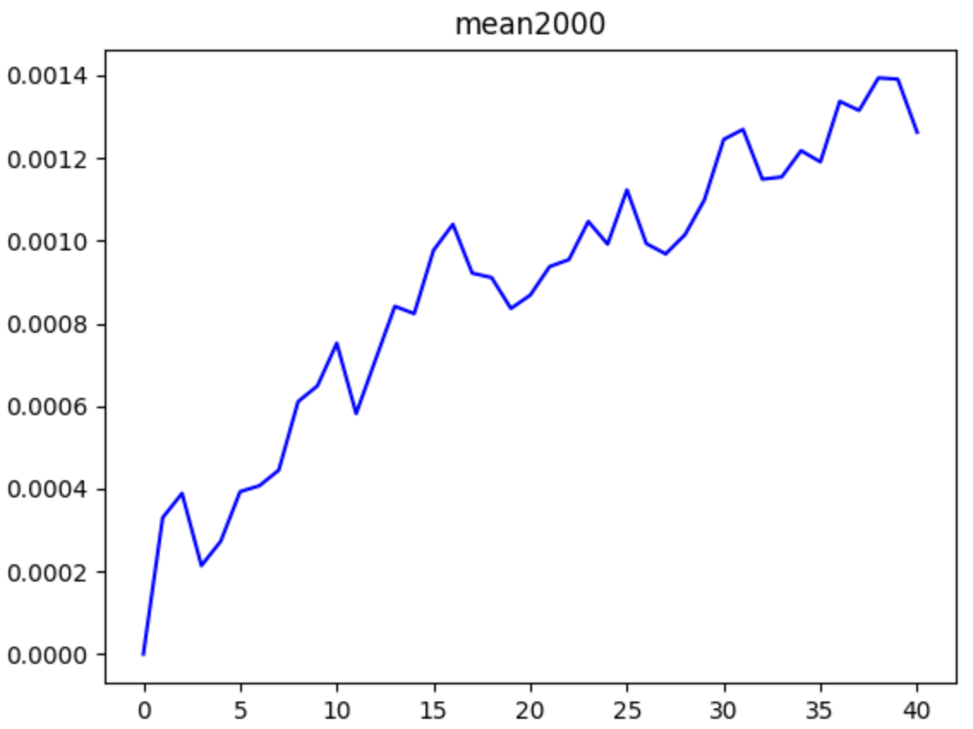
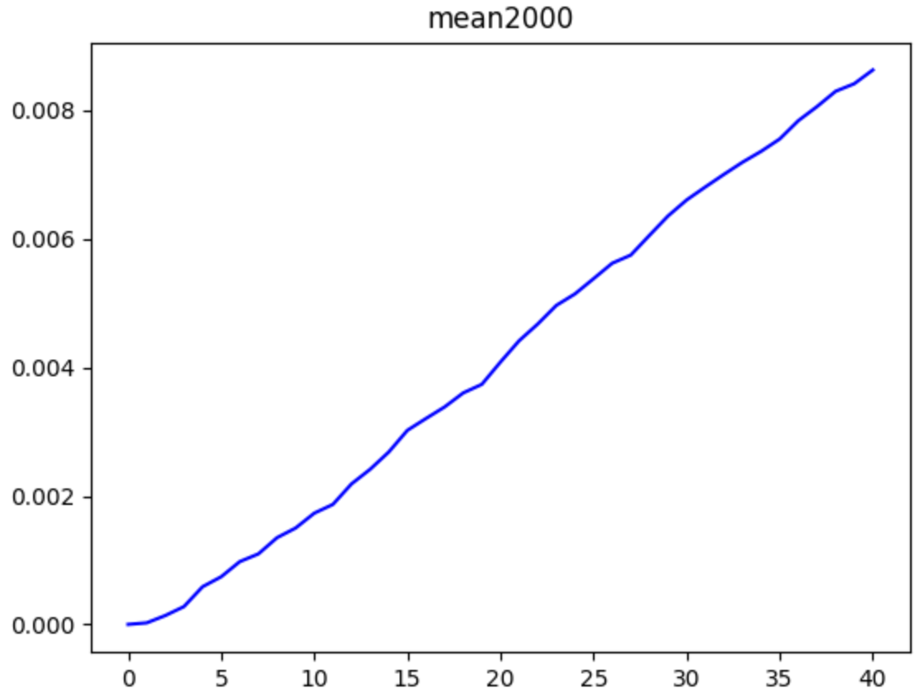
epoch
0
1
5
15
\
bs
200
800
1600
2000

Slide 3
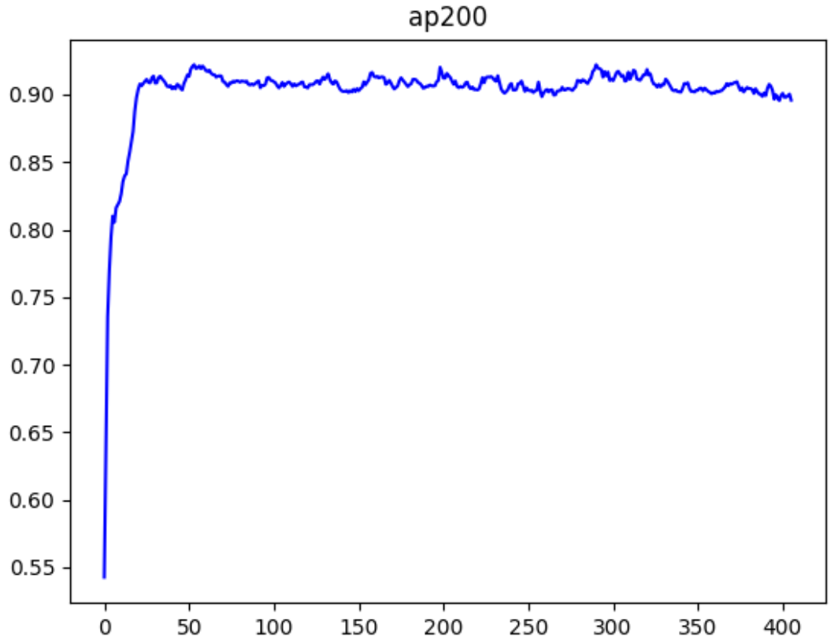
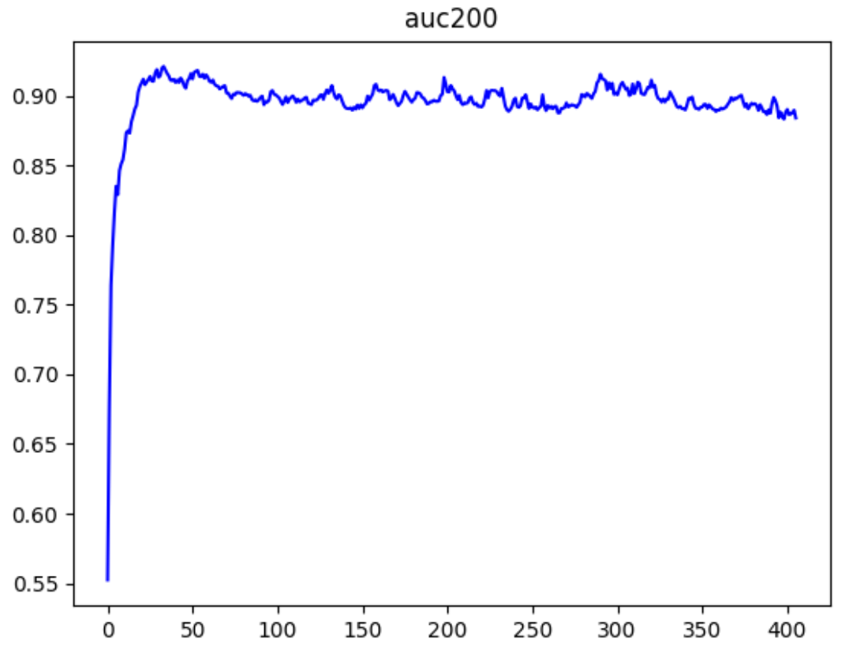
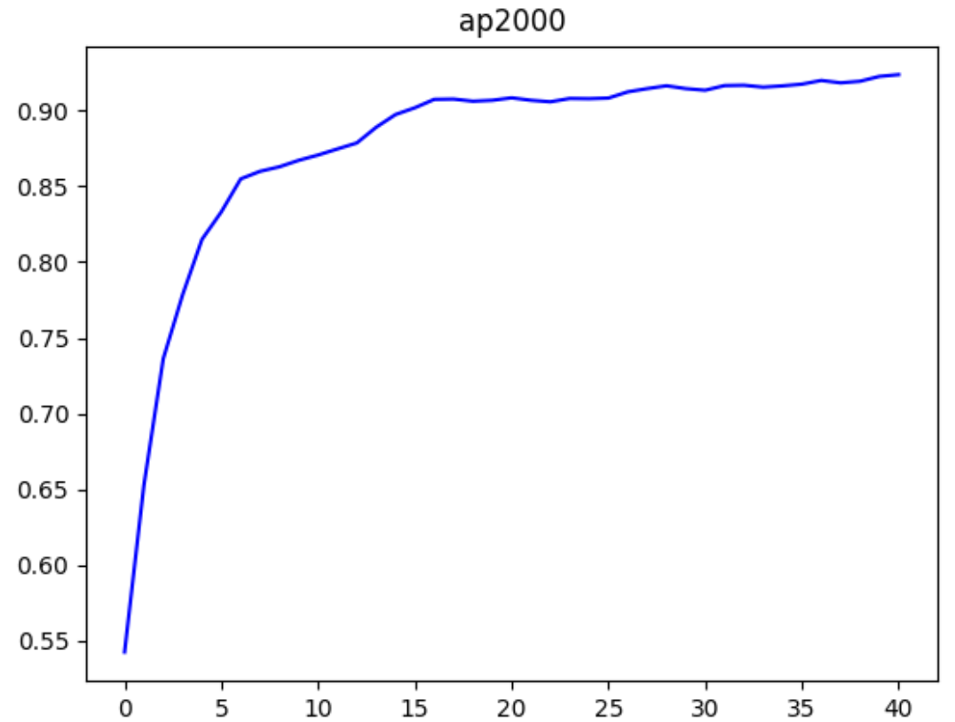
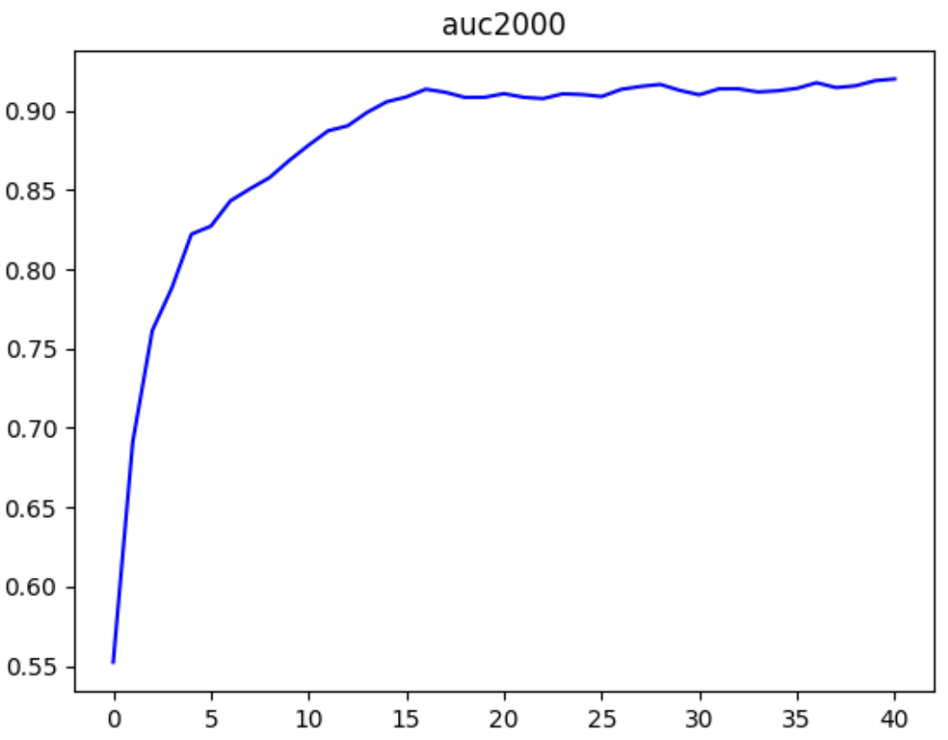
Accuracy

Slide 4
Define batch as the length of time interval
m | Test AP (Transductive) | Test AUC (Transductive) | Test AP (Inductive) | Test AUC (Inductive) | Time
5000 | 0.9848 | 0.9841 | 0.9786 | 0.9780 | 103.24
10000 | 0.9819 | 0.9810 | 0.9760 | 0.9745 | 74.67
20000 | 0.9797 | 0.9803 | 0.9718 | 0.9733 | 59.85
40000 | 0.9768 | 0.9754 | 0.9716 | 0.9696 | 30.55
bs | Test AP (Transductive) | Test AUC (Transductive) | Test AP (Inductive) | Test AUC (Inductive) | Time
200 | 0.9848 | 0.9841 | 0.9786 | 0.9780 | 103.24
800 | 0.9819 | 0.9810 | 0.9760 | 0.9745 | 74.67
1600 | 0.9797 | 0.9803 | 0.9718 | 0.9733 | 59.85

Slide 5
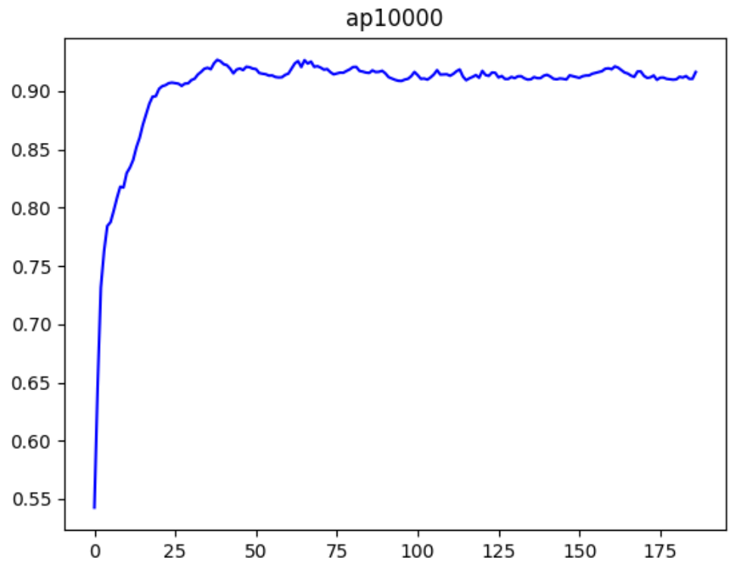
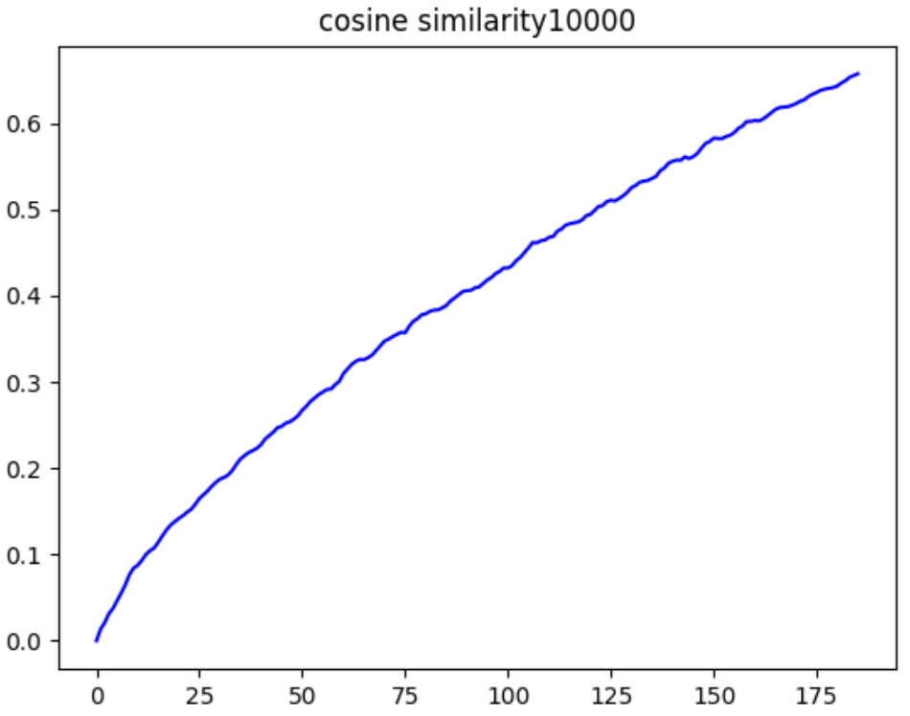
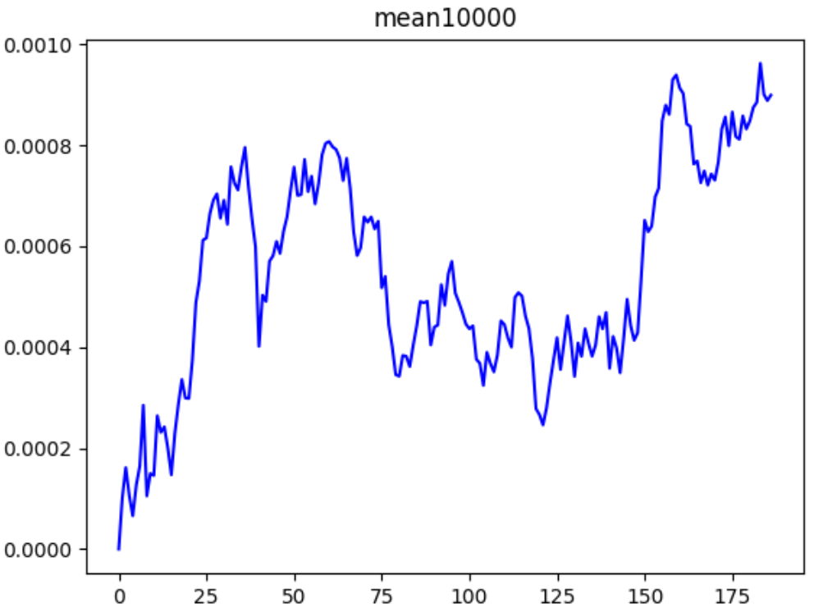
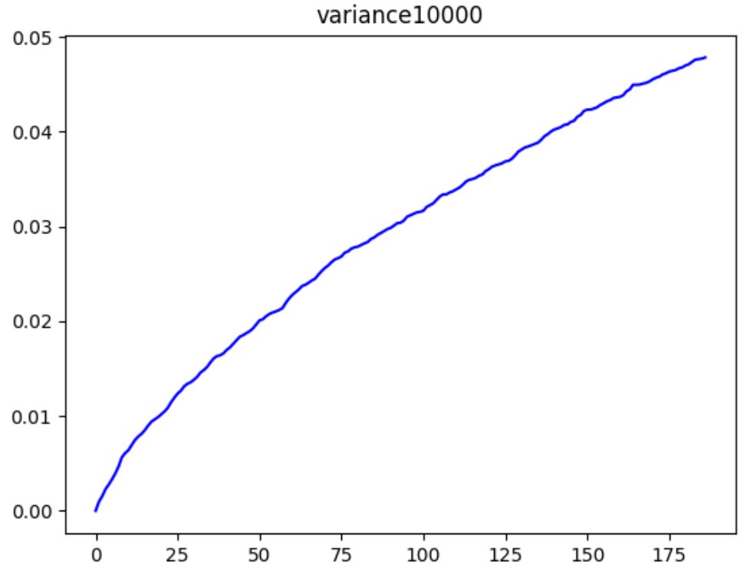
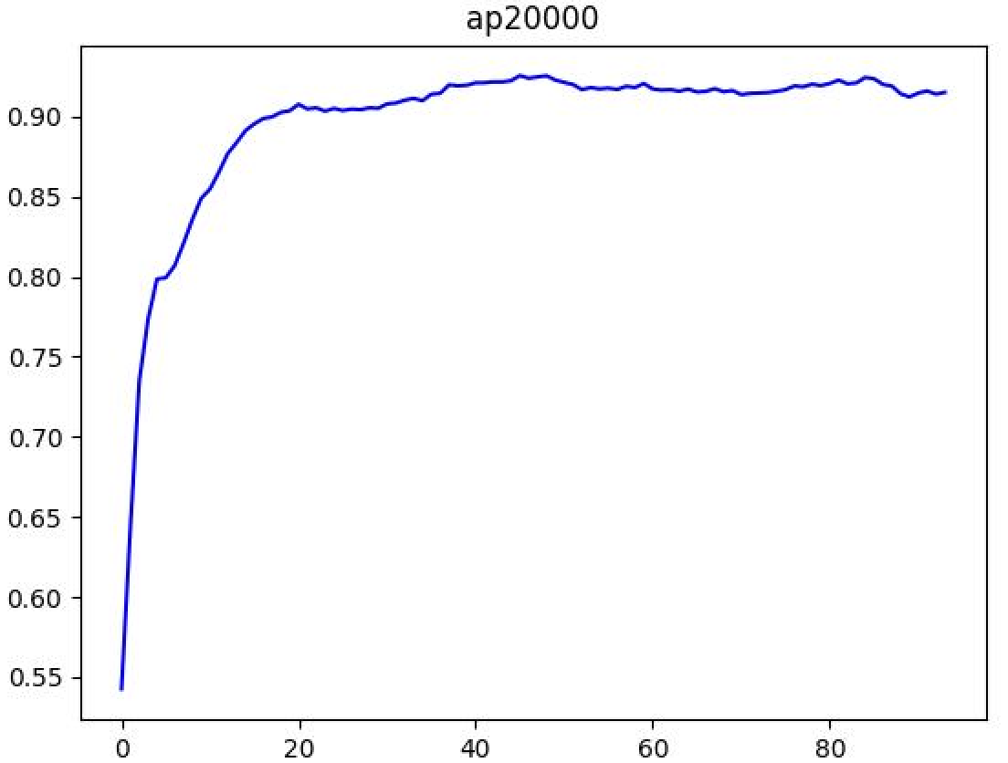
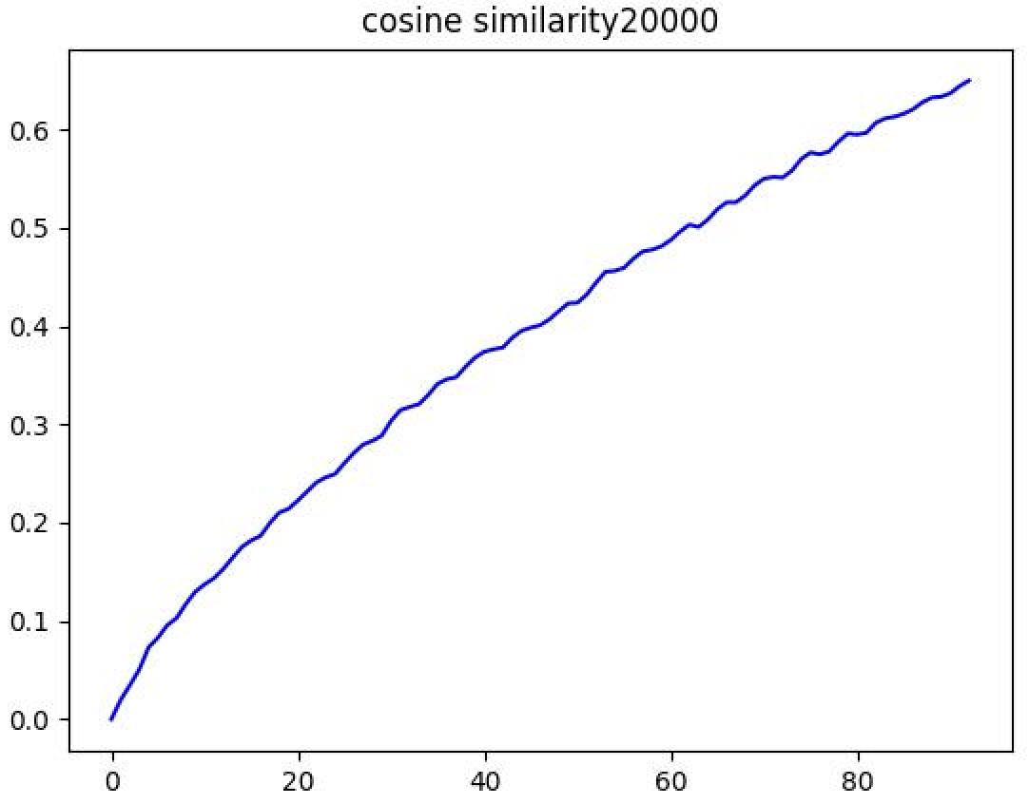
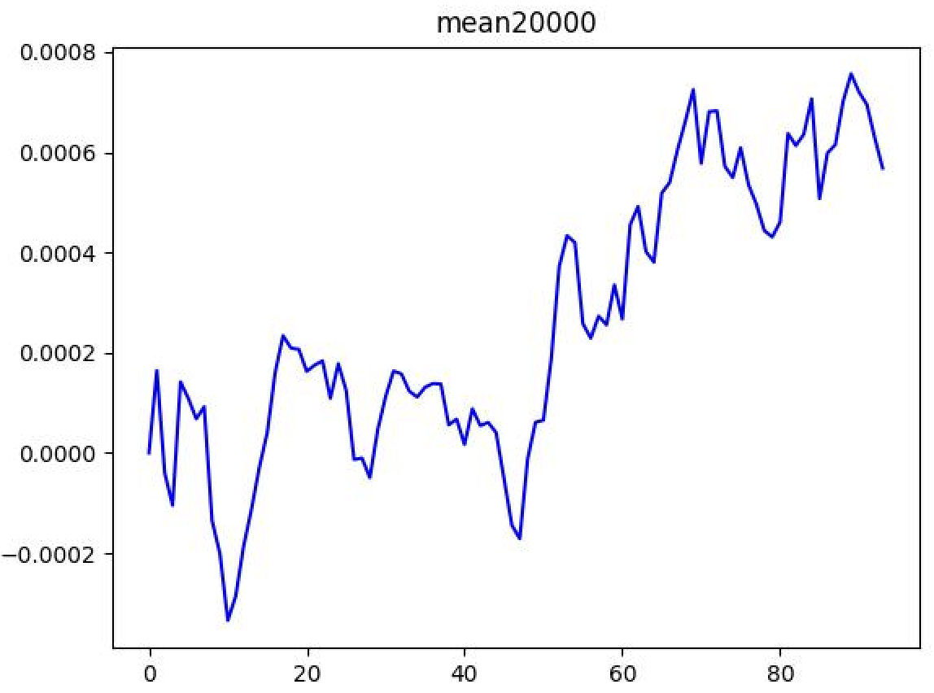
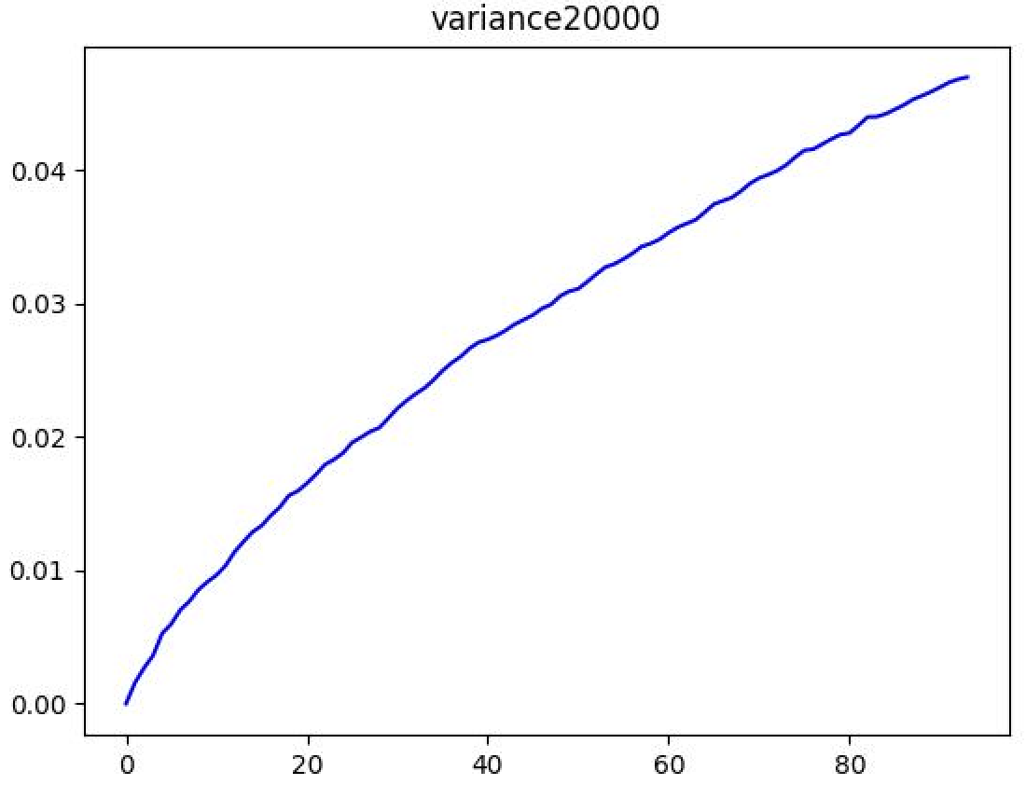
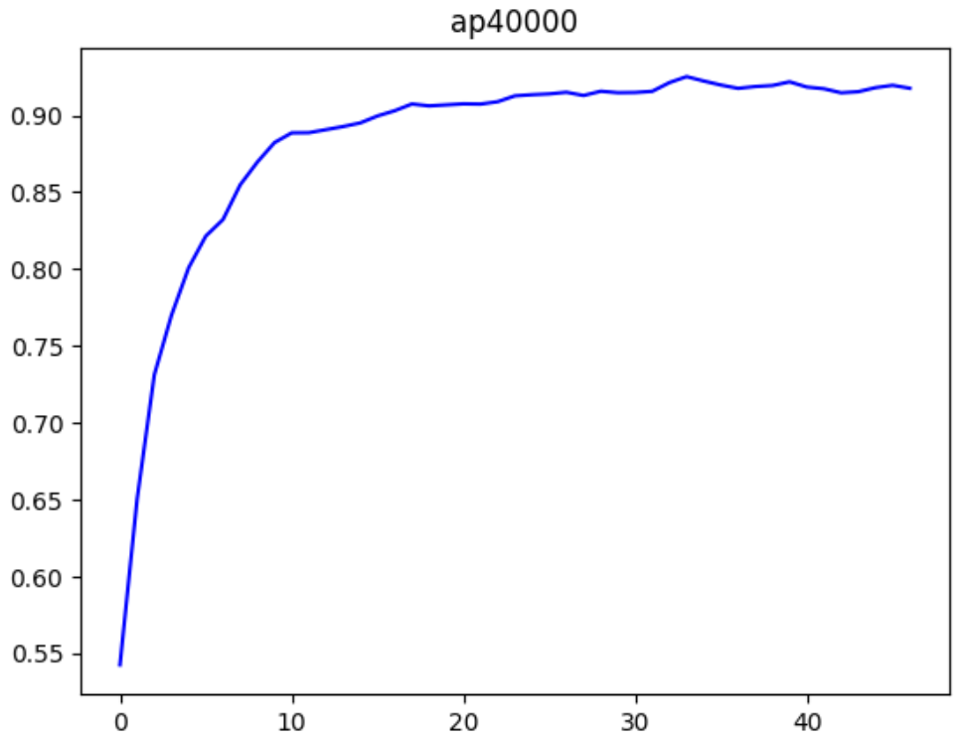
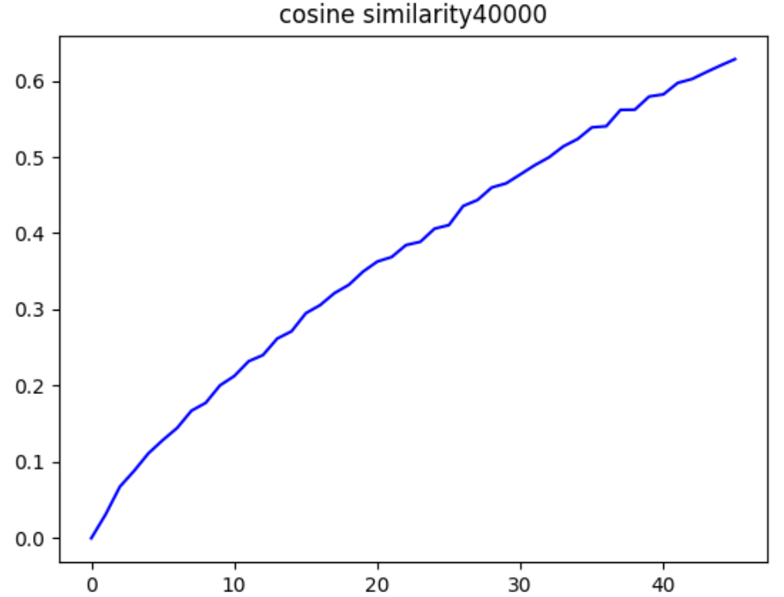
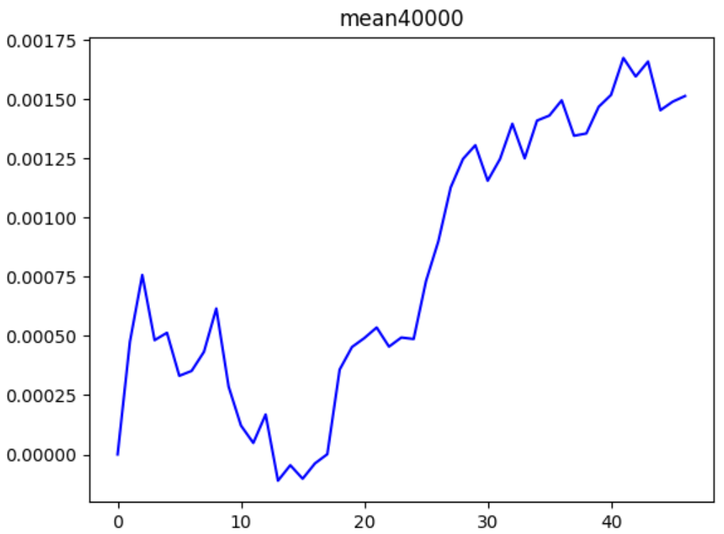
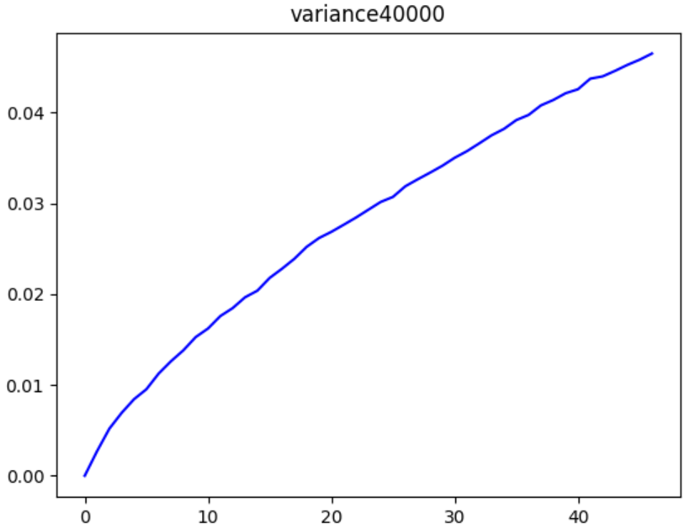

Slide 6
Degree-Accuracy
degree | Test AP | Test AUC
small | 0.6946 | 0.6775
average | 0.8760 | 0.8695
large | 0.9376 | 0.9273
epoch=0
degree | Test AP | Test AUC
small | 0.7405 | 0.7325
average | 0.8832 | 0.8713
large | 0.9427 | 0.9328
epoch=1
small: extract the first 20 vertices with smallest degree
large: extract the last 20 vertices with largest degree
average: extract vertices with degree in [avg_degree-1, avg_degree+1]

